Slide 1

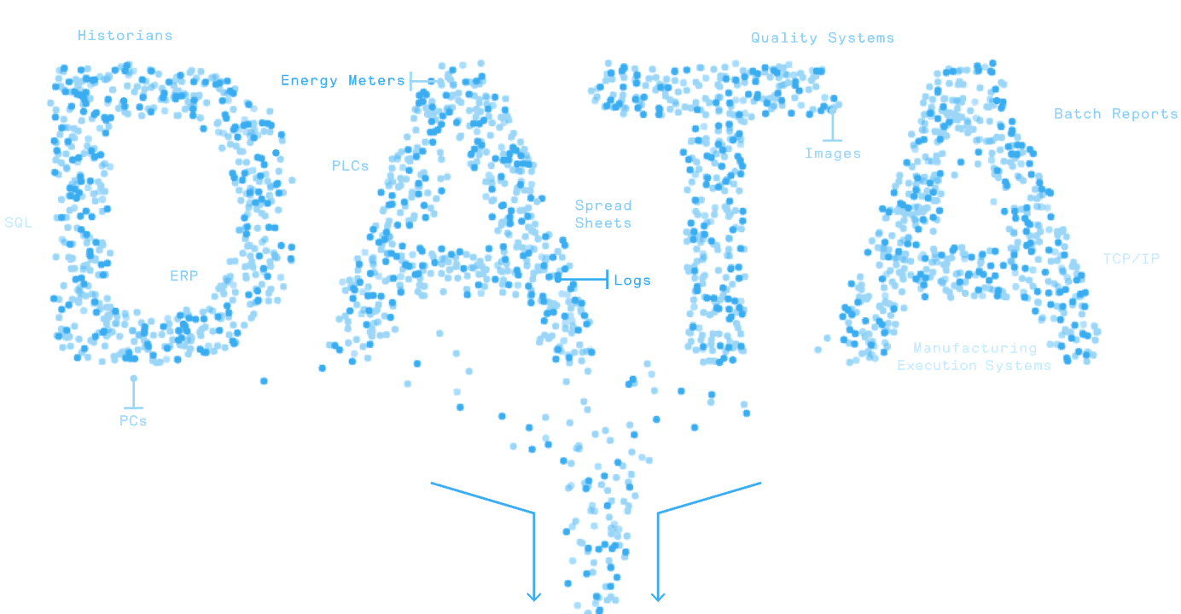

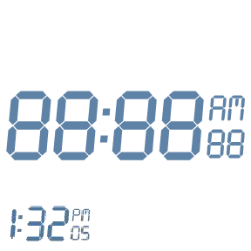
MATLAB Fundamental Laboratory Handbook (MATLAB)
Chapter 9 Programming and Algorithm Development
Dr Leo Chen
leo.chen@ieee.org
1

Slide 2


9. 1 Lab
Objective: From algorithm to MATLAB programming
Content：Write a function that computes the sequence to approximately calculate $π/4$
$$\frac{π}{4}≈1−\frac{1}{3}+\frac{1}{5}−\frac{1}{7}+⋯+\frac{{\left(−1\right)}^{n}}{2n+1}$$
edit pio4sol

Slide 3
9. 2 Lab
Objective: MATLAB programming tips of using preallocation
Content：Rewrite the function in lab 9.1 using preallocation.
edit pio4sol_pa

Slide 4
9. 3 Lab
Objective: MATLAB programming tips of using vectorization
Content：Rewrite the function in lab 9.1 using vectorization.
edit pio4sol_vec

Slide 5
9. 4 Lab
Objective: MATLAB programming tips of using vectorization
Content：Write a script that compares the three functions in lab 9.1, 9.2, and 9.3.
edit pio4sol_comp
pio4sol_comp

Slide 6
9. 5 Lab
Objective: Interactive programming with live script
Content：
Use live script to visualize the moving average of the given stock's price.
Adjust the parameter of moving average by sliding bar and observe the change of moving average.

